Slide 1

Predicting Customer Satisfaction for Airlines
Amrita Bhattacharya, PhD
Data Science Intensive Capstone Project, September 12th 2022 Cohort
Thanks to Springboard mentor, Kevin Ding

Slide 2

Introduction
Customer satisfaction is always top of mind for the aviation industry.
Unhappy or disengaged customers naturally mean fewer passengers and less revenue.
It’s important that customers have an excellent experience every time they travel.
The objective of this project is to predict whether a future customer would be satisfied with their service given the details of the other parameters values.
What factors affect customer satisfaction with the Airlines?
Can we predict the likelihood of a customer being satisfied with the Airline service?

Slide 3

Data
The data for this project is provided by Kaggle dataset.
This data is given by an airline organization. The actual name of the company is not given due to various purposes that's why the name Invistico Airlines.
The dataset consists of the details of customers who have already flown with them.
This data shows whether a customer is satisfied with the airlines or not after travelling with them.
There are several other measurement or to say feedback taken from the customers as well as their demographic data is also recorded.
The exercise is focused on implementing classification Machine learning algorithms to perform the analysis.

Slide 4
Data Wrangling
In the data wrangling section, I have cleaned and prepared the data.
Data Cleaning involved the process of dealing with missing values, looking for outliers in the data, checking class imbalance and labelling the accordingly.
Since, only one attribute contained 3% missing values , those missing records were dropped from the dataset.
The outliers in the variables 'Arrival Delay in Minutes', 'Departure Delay in Minutes' and 'Flight Distance' contains important information about the airlines. Hence, I didn't drop these outliers from the data.
In addition, while checking for any class imbalance, I found that the data is almost class balanced.

Slide 5
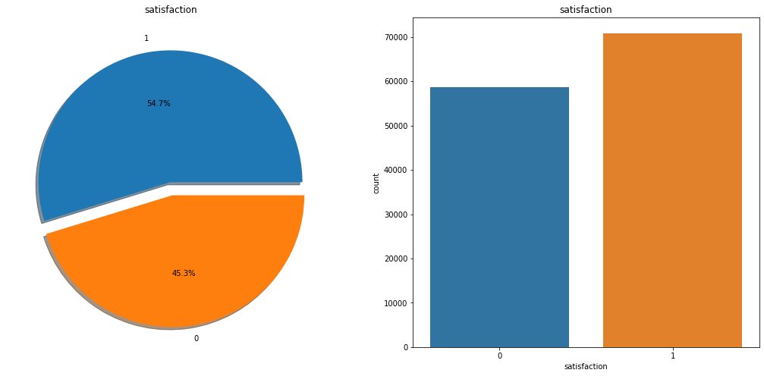
EDA (Exploratory Data Analysis)
54.7% people are satisfied with the Airlines and 45.3% are not satisfied with the Airlines.
Most satisfied customers lie in the age group of 41 years approx. and most dissatisfied customers lie in the age group of 38 years (approx).

Slide 6
EDA (Exploratory Data Analysis)
Most satisfied customers flew a flight distance of 1944.47 miles with the airlines and dissatisfied customers flew around 2025.203 miles with the airlines.
Most dissatisfied customers had an average delay of 18 minutes (approx) and satisfied customers had an average delay of 12 minutes (approx)with the airlines.

Slide 7
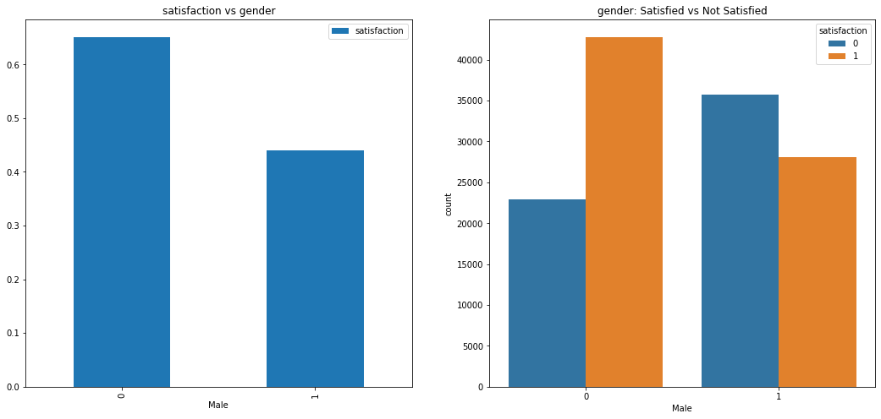
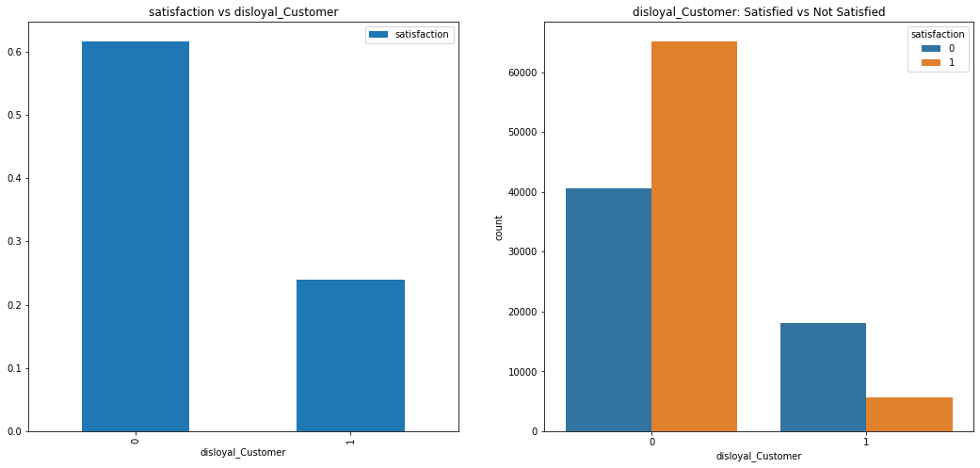
EDA (Exploratory Data Analysis)
Females are more satisfied than males. Males are more dissatisfied with the airlines.
Disloyal customers of the airlines are less satisfied compared to loyal customer.

Slide 8
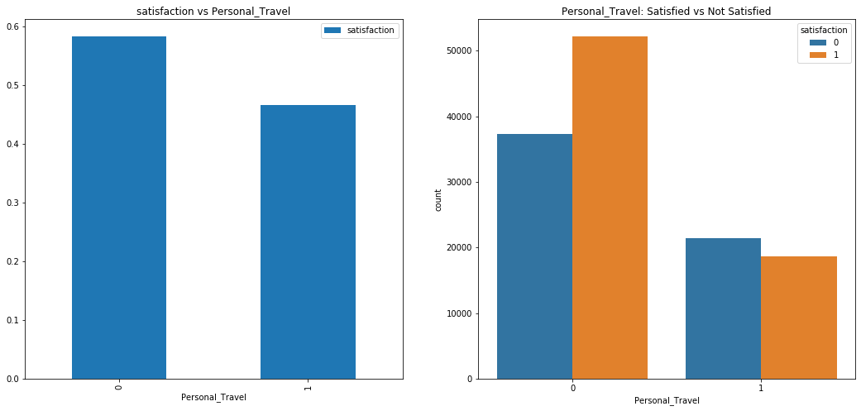
EDA (Exploratory Data Analysis)
Customers doing business travel are more satisfied compared to personal travel customers
A cleanliness level of 4 and 5 yields higher satisfaction among customers.
satisfaction | 0 | 1 | All
Cleanliness
0 | 5 | 0 | 5
1 | 4624 | 3122 | 7746
2 | 7953 | 5408 | 13361
3 | 16307 | 7600 | 23907
4 | 20110 | 28555 | 48665
5 | 9606 | 26197 | 35803
All | 58605 | 70882 | 129487

Slide 9
EDA (Exploratory Data Analysis)
A seat comfort level of 4 and 5 yields higher satisfaction among customers.
An Inflight_entertainment level of 4 and 5 yields higher satisfaction among customers suggesting better inflight entertainment provides higher
satisfaction | 0 | 1 | All
Seat_comfort
0 | 10 | 4771 | 4781
1 | 11466 | 9416 | 20882
2 | 18396 | 10249 | 28645
3 | 18734 | 10362 | 29096
4 | 9858 | 18457 | 28315
5 | 141 | 17627 | 17768
All | 58605 | 70882 | 129487
satisfaction | 0 | 1 | All
Inflight_entertainment
0 | 1007 | 1961 | 2968
1 | 9289 | 2479 | 11768
2 | 15861 | 3257 | 19118
3 | 19326 | 4807 | 24133
4 | 11696 | 30056 | 41752
5 | 1426 | 28322 | 29748
All | 58605 | 70882 | 129487

Slide 10
EDA (Exploratory Data Analysis)
A better ease_of_online_booking service will yield more satisfaction among customers as suggested by the ratings of 4 and 5 for ease_of_Online_booking service.
Inflight wifi service doesn't hold much importance for satisfaction because we can see that even if inflight wifi service has a got a rating of 2, the number of customers satisfied is more than no of customers dissatisfied.
satisfaction | 0 | 1 | All
Ease_of_Online_booking
0 | 18 | 0 | 18
1 | 10815 | 2582 | 13397
2 | 14192 | 5695 | 19887
3 | 14366 | 7978 | 22344
4 | 11233 | 28574 | 39807
5 | 7981 | 26053 | 34034
All | 58605 | 70882 | 129487
satisfaction | 0 | 1 | All
Inflight_wifi_service
0 | 72 | 58 | 130
1 | 10731 | 3939 | 14670
2 | 13415 | 13542 | 26957
3 | 13496 | 14022 | 27518
4 | 11382 | 20092 | 31474
5 | 9509 | 19229 | 28738
All | 58605 | 70882 | 129487

Slide 11
EDA (Exploratory Data Analysis)
Better onboard service will yield better satisfaction among customers as suggested by the ratings of 4 and 5 for onboard service.
Better leg room service will yield better satisfaction among customers as suggested by the ratings of 4 and 5 for leg room service.
satisfaction | 0 | 1 | All
On_board_service
0 | 5 | 0 | 5
1 | 9708 | 3515 | 13223
2 | 11283 | 5834 | 17117
3 | 15898 | 11061 | 26959
4 | 14301 | 26257 | 40558
5 | 7410 | 24215 | 31625
All | 58605 | 70882 | 129487
satisfaction | 0 | 1 | All
Leg_room_service
0 | 136 | 306 | 442
1 | 7953 | 3145 | 11098
2 | 13522 | 8161 | 21683
3 | 14071 | 8326 | 22397
4 | 12930 | 26653 | 39583
5 | 9993 | 24291 | 34284
All | 58605 | 70882 | 129487

Slide 12
EDA (Exploratory Data Analysis)
Better food and drink will yield better satisfaction among customers as suggested by the ratings of 4 and 5 for Food and drink.
satisfaction | 0 | 1 | All
Food_and_drink
0 | 1305 | 4617 | 5922
1 | 10326 | 10682 | 21008
2 | 15361 | 11717 | 27078
3 | 16036 | 12029 | 28065
4 | 11116 | 16013 | 27129
5 | 4461 | 15824 | 20285
All | 58605 | 70882 | 129487

Slide 13

Data Pre-processing
In the preprocessing section, I have prepared the data where dummies have been created for the categorical data.
Standardization have been done for all the numerical attributes.
The next slide shows the distribution of the data before standardization

Slide 14
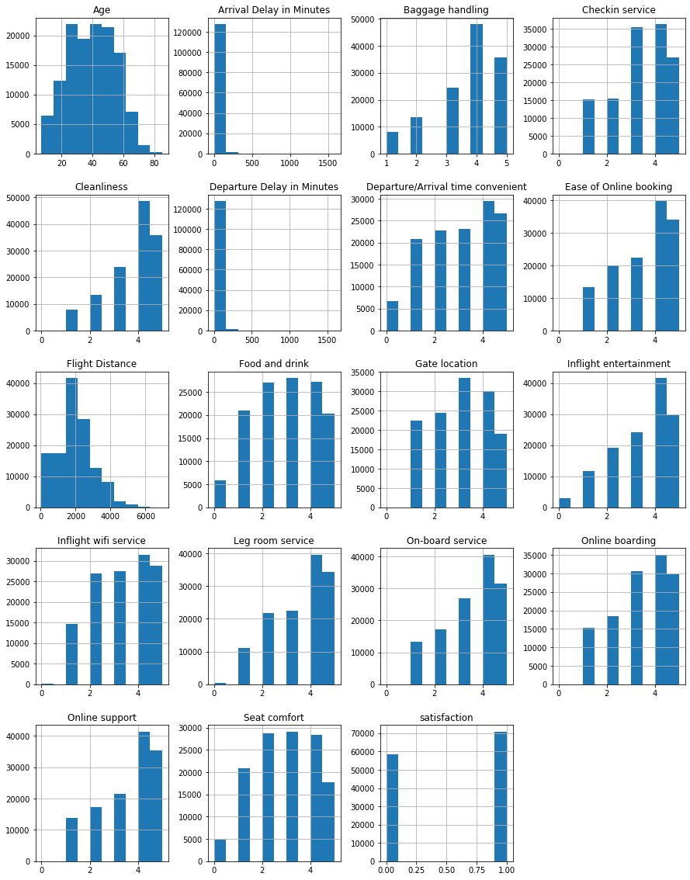

Slide 15

Modelling
In the modelling section, to predict whether a future customer would be satisfied with the Airlines service, I fit a Logistic Regression model and a Gradient Boost Classifier to check which is a better algorithm to perform the task.
To evaluate a better model, I look at the AUC scores for both training and test datasets for both the algorithms to understand which algorithm gives us a better performance.
I also look at VIF (Variance Influence Factor) to look for multicollinear variables. Any explanatory variable having a VIF>10 is a indication of multicollinearity present in the model. Hence, multicollinearity issues have been taken care of before finalzing the model.

Slide 16
Results (Logistic Regression)

Slide 17

Logistic Regression Results
Some key findings that most likely explains the relationship between each of the independent and dependent variable.
Higher age group customers are less likely to be satisfied with the Airlines.
Higher arrival delay is more likely to generate dissatisfied customers.
Customers flying higher flight distance with the Airlines are less likely to be satisfied with the Airlines.
The results suggest that female customers are more satisfied with the Airlines service.
The positive coefficient signs suggest that better seat comfort, Inflight_entertainment, On_board_service, Leg_room_service, Checkin_service and Online_boarding are more likely to generate more satisfied customers for the Airlines.

Slide 18
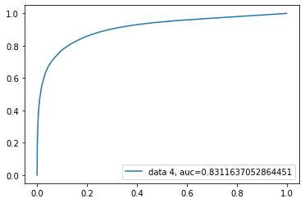
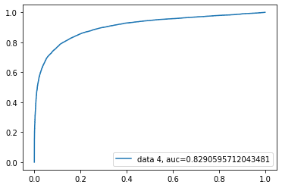
Logistic Regression (Performance)
Training
Test

Slide 19
Modelling
In the Logistic Regression output, we find all our explanatory variables are highly significant.
To evaluate the model, I look at the AUC scores for both training and test datasets.
The AUC score for Logistic Regression model is 0.83 approx. for both training and test data sets.
To achieve a better AUC score, I decided to refit the model using Gradient Boost Classifier and check the model performance again.

Slide 20

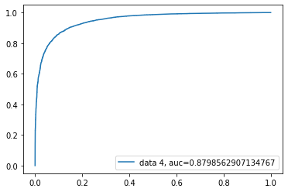
Gradient Boost Classifier (Performance)
Training
Test

Slide 21
Modelling
Looking at the final AUC scores for both Logistic Regression and Gradient Boost Classifier, we conclude that Gradient Boost Classifier is a better model to analyze the given task.
Both AUC score of training and test are approx. 0.88 for Gradient Boost Classifier suggesting there is no form of overfitting in the model.

Slide 22

Conclusion
The dataset contributed to the predictive power of the model.
Out of the two classification models, Gradient Boost Classifier provided the best results.
Out of 24 features, we used only 16 features for the best model
With 80%-20% splitting, the test data set gave AUC = 0.88 (approx.) with the Gradient Boost Classifier algorithm.
With more ideas, the model can be improved in the future.
In the future I would like to spend more time gathering some additional data, if available, and also trying out different other ML classification algorithms as further robustness checks.

Slide 23
THANK YOU!

